Slide 1
Kriptografija zasnovana na simetričnom ključu (eng. symmetric key cryptography)

Slide 2
Kriptografski sustav

Slide 3
Kriptografski sustav: definicija

Slide 4
Kerckhoffsov aksiom (princip)*

Slide 6
Klasični (simetrični) kriposustavi

Slide 7
Cezarova (shift) sifra

Slide 8
Monoalphabetic Ciphers

Slide 9
Monoalphabetic Ciphers: kriptoanaliza

Slide 10
Monoalphabetic Ciphers: kriptoanaliza

Slide 11
Polyalphabetic Ciphers

Slide 12
Vernam i “One-Time Pad” sifre

Slide 13
Permutacijske sifre

Slide 15
Block vs. Stream Cipher

Slide 16
Data Encryption Standard (DES)

Slide 17
Data Encryption Standard (DES)

Slide 18
Data Encryption Standard (DES)

Slide 19
Data Encryption Standard (DES)

Slide 20
Data Encryption Standard (DES)

Slide 21
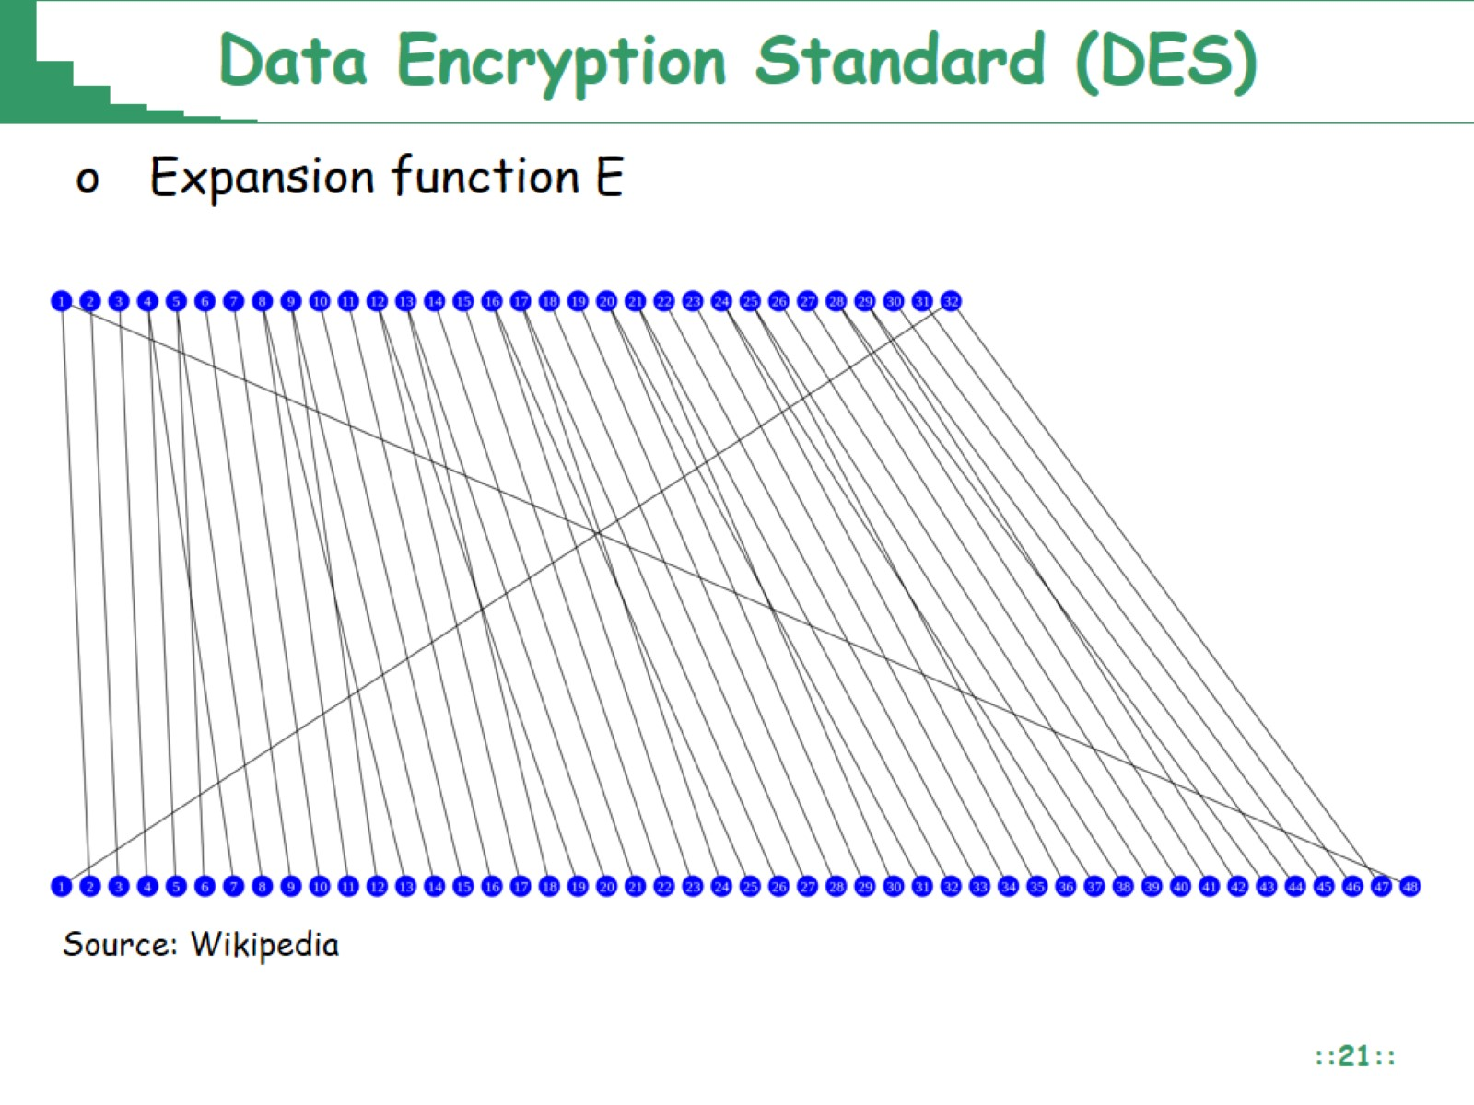
Data Encryption Standard (DES)

Slide 22
Data Encryption Standard (DES)

Slide 23
Data Encryption Standard (DES)

Slide 24
Toy example: DES encryption (2 rounds)

Slide 25
Toy example: DES encryption (2 rounds)

Slide 26
Toy example: DES decryption (2 rounds)

Slide 27
Toy example: DES decryption (2 rounds)

Slide 28
Sigurnost DES-a

Slide 29
Advanced Encryption Standard (AES)

Slide 30
Advanced Encryption Standard (AES)

Slide 31
Advanced Encryption Standard (AES)

Slide 32
Advanced Encryption Standard (AES)

Slide 33
Advanced Encryption Standard (AES)

Slide 34
Advanced Encryption Standard (AES)

Slide 35
Advanced Encryption Standard (AES)

Slide 36
Advanced Encryption Standard (AES)

Slide 37
Advanced Encryption Standard (AES)

Slide 38
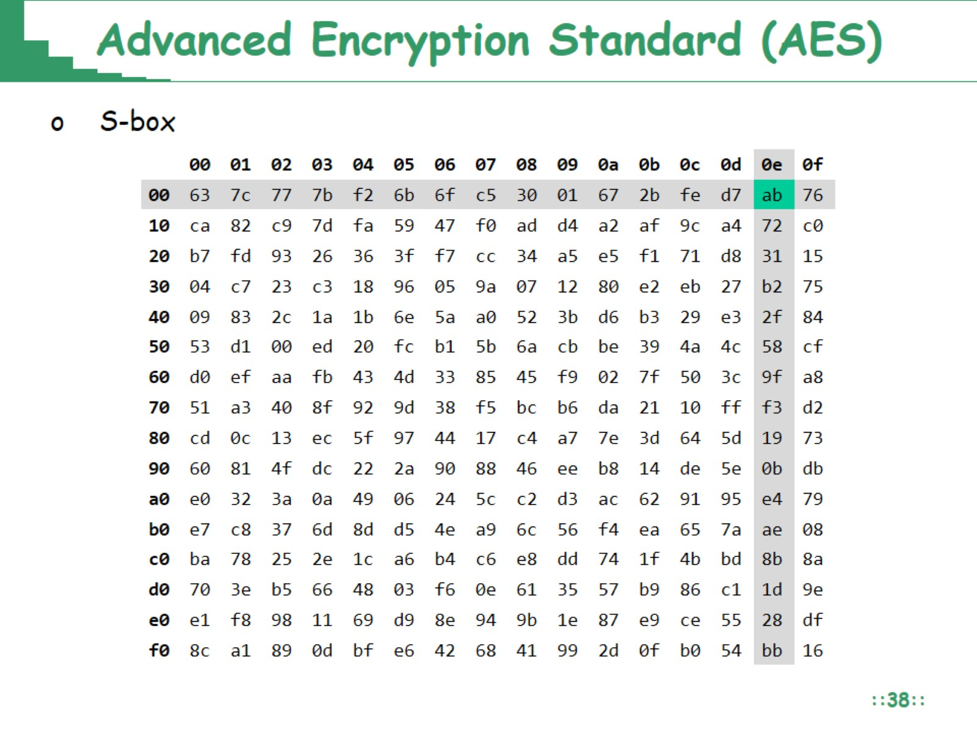
Advanced Encryption Standard (AES)

Slide 39
Advanced Encryption Standard (AES)

Slide 40
Advanced Encryption Standard (AES)

Slide 41
Comparison of DES, 3DES and AES

Slide 42
Brute-Force Attack

Slide 44
Osnovni modovi rada blok sifri

Slide 45
Electronic Codebook (ECB) Mode

Slide 46
Svojstva ECB moda

Slide 47
Nedostaci ECB moda

Slide 48
Cipher Block Chaining (CBC) Mode

Slide 49
Cipher Block Chaining (CBC) Mode

Slide 50
Cipher Block Chaining (CBC) Mode

Slide 51
Cipher Block Chaining (CBC) Mode

Slide 52
Svojstva CBC moda

Slide 53
Svojstva CBC moda

Slide 54
Integritet IV u CBC modu

Slide 55
Counter (CTR) mode

Slide 56
Counter (CTR) mode

Slide 57
Svojstva CTR moda

